Slide 1

Fraudulent Transaction Segmentation using Unsupervised Learning Under the guidance of Mr. Ram Kumar Alka Agarwal Kunaal Jha Nikhil Choudhary Tushar Jethani Vanshika Arora Group 7

Slide 2

Problem Statement
Using Unsupervised Learning to segment different cyber attacks and provide an analysis report for network intrusions and fraudulent transactions

Slide 3
Introduction to the domain
A network intrusion is any unauthorized activity on a digital network
Network intrusions often involve stealing valuable network resources and data and jeopardizing the security of network and their data
With advancement in technology, these network intrusions and fraudulent transactions have increased and hence they need to be identified to prevent such attacks.

Slide 4
Why is this a major problem?
As per a Cyber Security Report by CISCO, 53% of cyber attacks caused more than $5 lakh of financial loss to organizations in India in 2018.
In 2019, there were 80,000 cyber attacks per day
41% of companies have over 1,000 sensitive files including credit card numbers and health records left unprotected
Ransomware attacks are growing more than 350% annually
India has faced a rise of 7.9% in data breaches since 2017.
Cyber criminals will steal an estimated 33 billion records in 2023

Slide 5
Value proposition/ Solution planned by the team
Information gathered from this study can be passed onto such organizations which will help them have an in-depth understanding of how network intrusions and fraudulent transactions work and effect formidable detection and prevention systems.

Slide 6
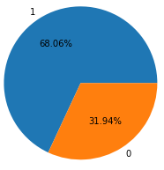
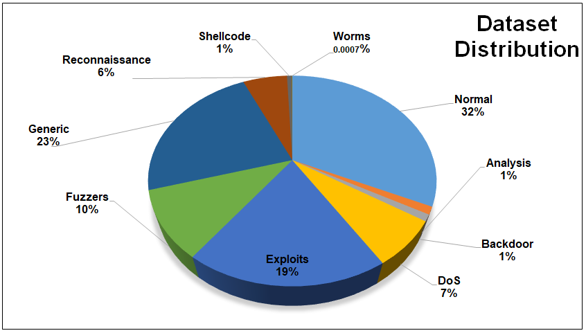
Dataset Description
Dataset consists of:
37 numerical features
5 categorical features
Number of records : 175,341
2 target variables namely ‘label’ and ‘attack category’

Slide 7
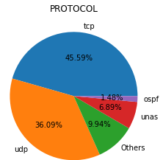
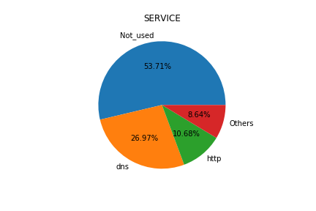
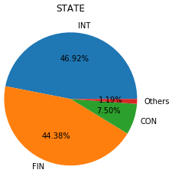
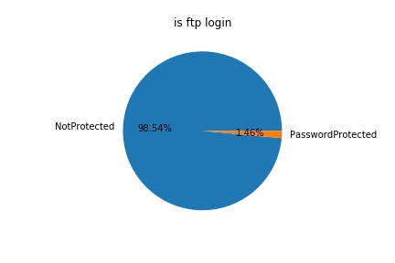
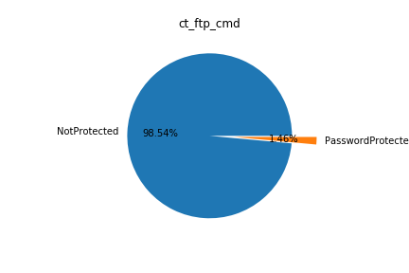
Exploratory Data Analysis
Exploratory
Data
Analysis

Slide 8
Insights
Almost all the numerical features are right skewed
Most of the transactions are done without using any service i.e. service=Not_used
For trans depth of 3 and higher, there is no normal transaction
For dns service, almost 80% of the attacks are ‘Generic’
HTTP service used with TCP has high number of attacks
DNS service used with UDP has high number of attacks
On an average, very high value of destination bits per second(dload) means there is no attack whereas a very low value of destination bits per second means that there is presence of cyber attack.
Mean Destination inter-packet arrival time is highest for 'Fuzzer' whereas lowest for 'Generic'.
Mean Source and Destination jitter time is lowest for 'Generic', followed by 'Backdoor'.

Slide 9
Presence of Outliers and their treatment
From the distribution plot of numerical features, it can be seen that the features are right skewed and hence there are outliers present at the right or higher side of the data
Higher values have lower frequency
These outliers are a significant part of the data and help in understanding the patterns and making clusters and not a noise in the data
Therefore, these outliers are not treated and left as it is

Slide 10
Statistical Significance of variables
Following features are insignificant in determining different attack categories as per ANOVA test:
“Analysis” - ackdat, dloss and response_body_len
“Backdoor” - sjit, synack, ackdat, sbytes, response_body_len and dloss
“DoS” - sjit, ackdat, spkts, smean and response_body_len
“Exploits” - dpkts and dbytes
“Fuzzers” - dpkts and dbytes
“Generic” - ackdat, dloss and response_body_len
"Reconnaissance“ - dinpkt, ackdat, sjit
“Shellcode” - sjit, rate, ackdat, dinpkt, sbytes, sloss and response_body_len
“Worms” - sjit, dur, dinpkt, ackdat, spkts, dbytes, sloss, dtcpb, smean and djit

Slide 11
Algorithms Considered
K-means algorithm
is an iterative algorithm
uses Euclidian distance method
Partitions the dataset into k - defined clusters.
Cons: can’t be used to cluster categorical features
Pros : simple and efficient for large datasets.
For clustering categorical features, we have K-modes.
For mixed data types, there is K-prototype which used hamming distance for categorical features.
Another algorithm is Gower Distance with hierarchical clustering.
Cons:
Both the algorithms are not fully developed
Very slow and not efficient
Can’t be used for large datasets

Slide 12
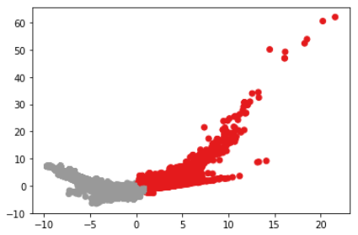
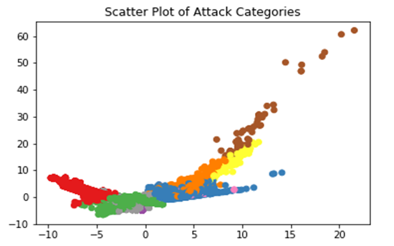
Scatter Plot of Label
2 clusters can be separated easily. Features which were most helpful in separating the clusters are – proto, state, service, dpkts, sbytes, dbytes, rate, ct_srv_src, sloss, is_ftp_login, stcpb, dtcpb, is_sm_ips_ports
Clusters defining attack category are not very much separable.
Some of the features that were still able to separate the clusters are – proto, state, service, dur, ct_state_ttl , sbytes , dpkts and rate.

Slide 13
While using TCP protocol along with 'dns' service, there are more chances of attack being happened
While using 'ospf' protocol with less time to live in network, most likely the transactions being normal
Most of the attack happens while using 'udp' protocol
While using 'ospf' protocol, no 'Worms' attacks happened but no transaction was normal
When is_sm_ips_ports = 1, then there are no attacks.
TCP is a more secure protocol than udp and unas
For high values of sbytes, dbytes, sloss, dloss all are attacks.
Conclusion

Slide 14
Thank
You

